Slide 2
UPDATING OF THE PRESELECTED COUNTRIES PROFILES
WP4
Justine RUELLE
10/06/2021

Slide 3
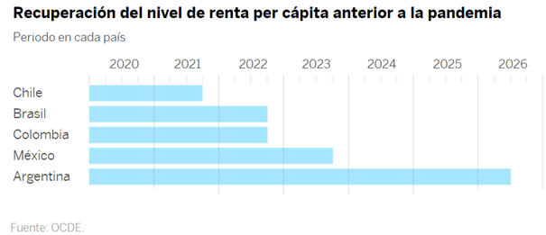
INTRODUCTION

Slide 4
BUSINESS CLIMATE AND
ECONOMIC SITUATION
Argentina | Brazil | Chile | Colombia | Mexico | Peru
In January 2021, IMF estimated GDP growth of 4.5%. For the years 2022 and 2023, the international financial body forecasts Argentine GDP growth rates of 2.5% and 1.5% respectively. This rebound in the Argentine economy would occur after 3 consecutive years of recession that the country has experienced, between the period 2018-2020. | Economic activity resumes after the 2nd wave (March-mid May) in almost all sectors of activity. The statistics of the last few weeks are quite good but we remain on a high level. | After a 6% drop in GDP in 2020, the OECD expects growth of 6.7% for 2021, thanks in particular to the rise in the price of copper - the highest since 2011 - and the dynamism of the vaccination campaign (39.7% of the population received a 1st dose at least on 19/04). | GDP contracted by 6.8% in 2020 according to the IMF. In 2021, the IMF expects a recovery of 5.1% but the assumptions remain highly dependent on the current vaccination policy and the impact of social tensions. | The World Bank is improving its growth outlook for Mexico and forecasts growth of around 5.5% in 2021, compared to 3.7% forecast in January. The speed of vaccination, US growth and the recovery in the labor market have notably contributed to improved growth prospects. The IMF is also improving its growth prospects for the Mexican economy from 4.3% to 5% in 2021. Total reopening of economic and tourist activity. | Currently, there are only a few prohibited economic activities. In 2020, the GDP fell by 11.1%. In Q1 2021, GDP grew by 3.8% (INEI estimate). The IMF estimates that the GDP will grow by 8.5% in 2021.

Slide 5
HEALTH SITUATION IN THE COUNTRY
Argentina | Brazil | Chile | Colombia | Mexico | Peru
After a sharp increase in cases, new contagions seem to be slowing down. The strict quarantine put in place until 31/05 has been lightened, with restrictions based on the epidemiological situation of the regions and a curfew from 6 p.m. | Federal State therefore different realities according to the States. Resumption of decompartmentalization in many cities, notably in SP, Rio and Brasilia. | Progressive deconfinement plan in 5 stages. Massive vaccination campaign, with the objective of vaccinating 80% of the Chilean population by the end of the first half of 2021 (as of May 31, 40.8% of the population had received the 2 doses). | The occupation of intensive care units in the country is now 91.5% and almost 100% for Bogota. With more than 11,400 deaths in the month of May, the country reached a new peak of contagions. Curfew still in effect. In total, Colombia has more than 85,200 deaths (and more than 17,000 "suspicious deaths") and nearly 3.2M cases. At the same time, as of May 26, 6.1% of the population received the first dose. The health emergency is extended until August 31 | With more than 230,000 deaths, Mexico is now the fourth most affected country in the world after the United States and Brazil. However, no more federated states out of 32 are now classified as a red light, which corresponds to a hospital occupancy rate of over 65%. 25 states are on orange light (including Mexico City) and 7 are green. | Since January 2021: the Government has been implementing a strategy of measures. The national state of emergency (curfew) continues until June 30. The vaccination campaign started on February 9: 11.1% of +18 year olds received 1 dose and 4.8% are completely immune

Slide 6
SITUATION RELATED TO BUSINESS TRIPS AND IVE
Argentina | Brazil | Chile | Colombia | Mexico | Peru
Partial border closure: access free for Argentines residents under certain conditions. Compulsory confinement on arrival in the country and PCR tests required on arrival in the country and 7 days after arrival, to get out of confinement. I.V.E departures are temporarily suspended. | Resumption of regular flights but with compulsory quarantine on arrival (10 days, negative PCR test on departure). I.V.E departures are temporarily suspended. Development of a local offer (student visa in Brazil can become VIE) | Border closures to foreign tourists, with some exceptions; I.V.E missions are possible under certain conditions. | The country's air borders are open. Regarding international travel, a PCR test of less than 96 hours before boarding must be presented on a flight to Colombia. I.V.E departures are temporarily suspended. | No restriction. I.V.E missions are authorized | Tourists entering Peru must present a negative PCR test with a maximum seniority of 72 hours before the flight. I.V.E missions are possible under certain conditions.

